Slide 1




ERP FOR FACULTY MODEL
GUIDED BY :
Dr. KRUTI DANGARWALA
PREPARED BY:
HETVI H. PRAJAPATI(210450131031)
SWETA DAS (210450131017)
KASHISH K.SARVAN (220453131008)
ALPESH SUTARIYA(210450131034)

Slide 2
INTRODUCTION TO THE SLIDES
Introduction to ERP system
Agenda of creating ERP system
Observation:
Research on various ERP System
UML Diagrams
Implementation
References
AEIOU
Empathy Mapping / Framework
Mind Mapping/Framework
Ideation Canvas / Framework
Product Development Canvas / Framework
Learning Need Matrix Canvas

Slide 3

INTRODUCTION TO ERP SYSTEM
4 KEY POINT OF AND ERP SYSTEM
Security :
Provides different access levels and user roles for administrators, faculty, students, and other staff members to ensure data security and confidentiality.
Mobile Accessibility:
Offers mobile accessibility, allowing stakeholders to access information and perform tasks on the go using smartphones or tablets.
Definition:
It’s a software designed to integrate various administrative and academic processes within a college or educational institution.
Information:
Manages faculty records, including personal details, qualification , student
attendance, and disciplinary history.

Slide 4

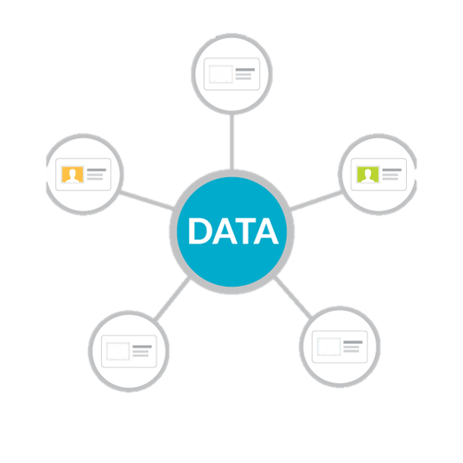


AGENDA OF CREATING ERP SYSTEM
Student lifecycle management
Centralized data management
Automation of processes
Financial management

Slide 5
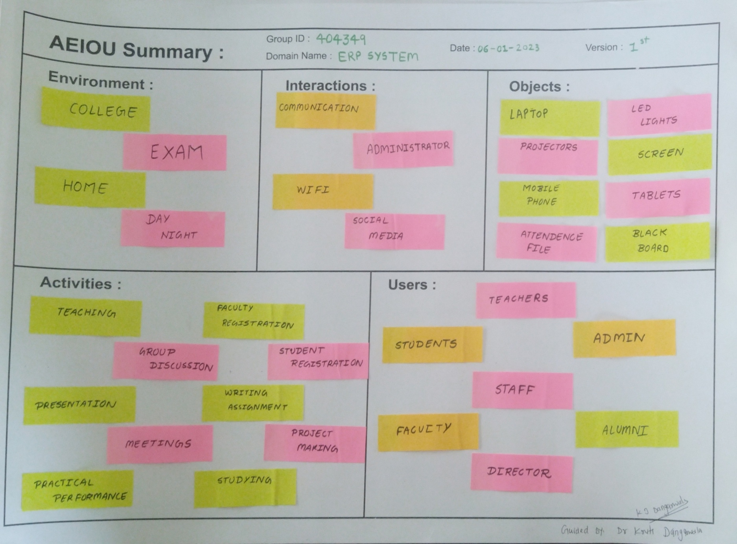
OBSERVATION
Mainly we do our observation through following 5 aspects.
It consist of AEIOU framework.
A=Activity
E=Environment
I=Interaction
O=Object
U=User

Slide 6
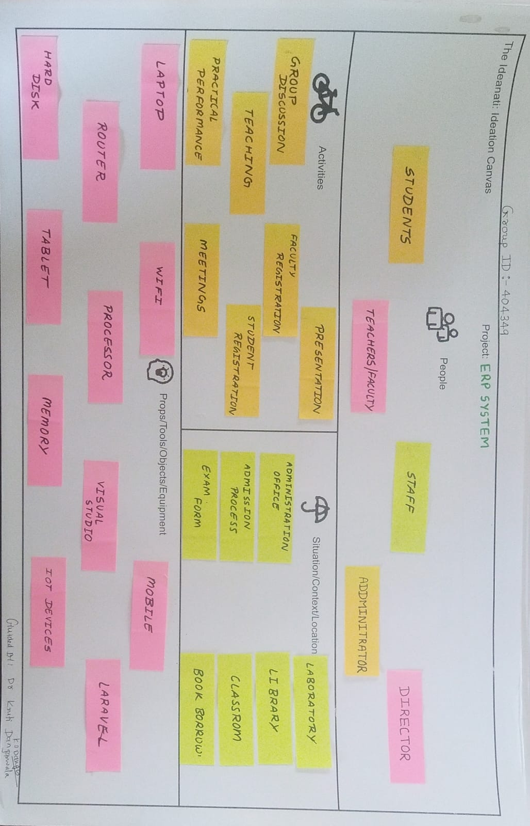
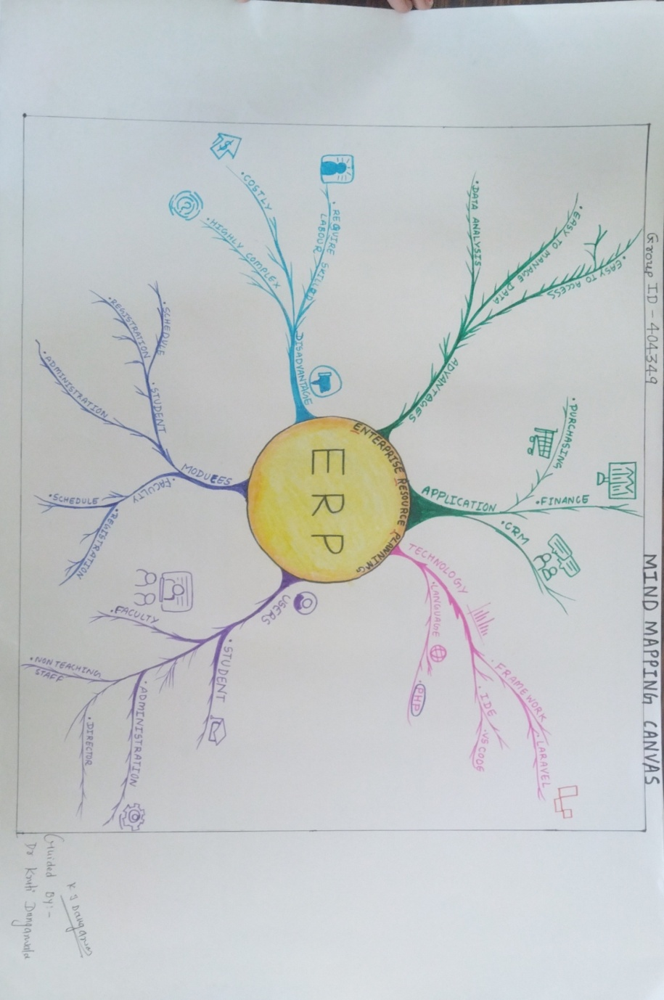
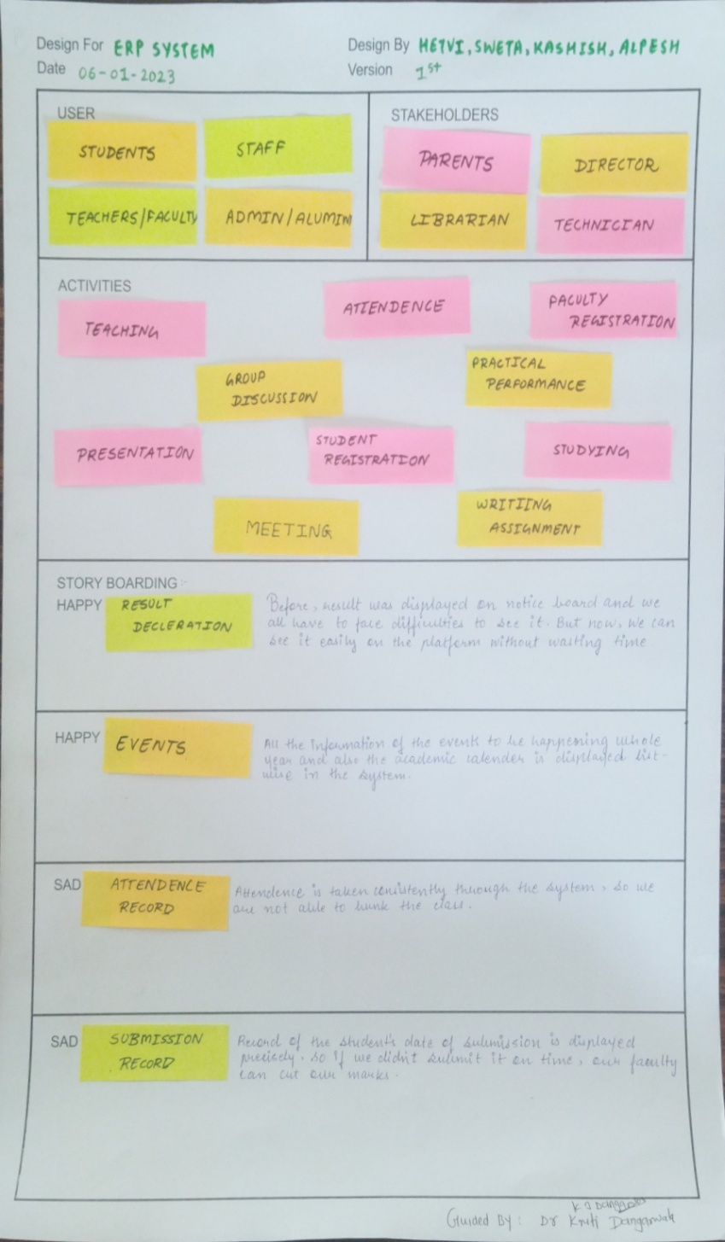
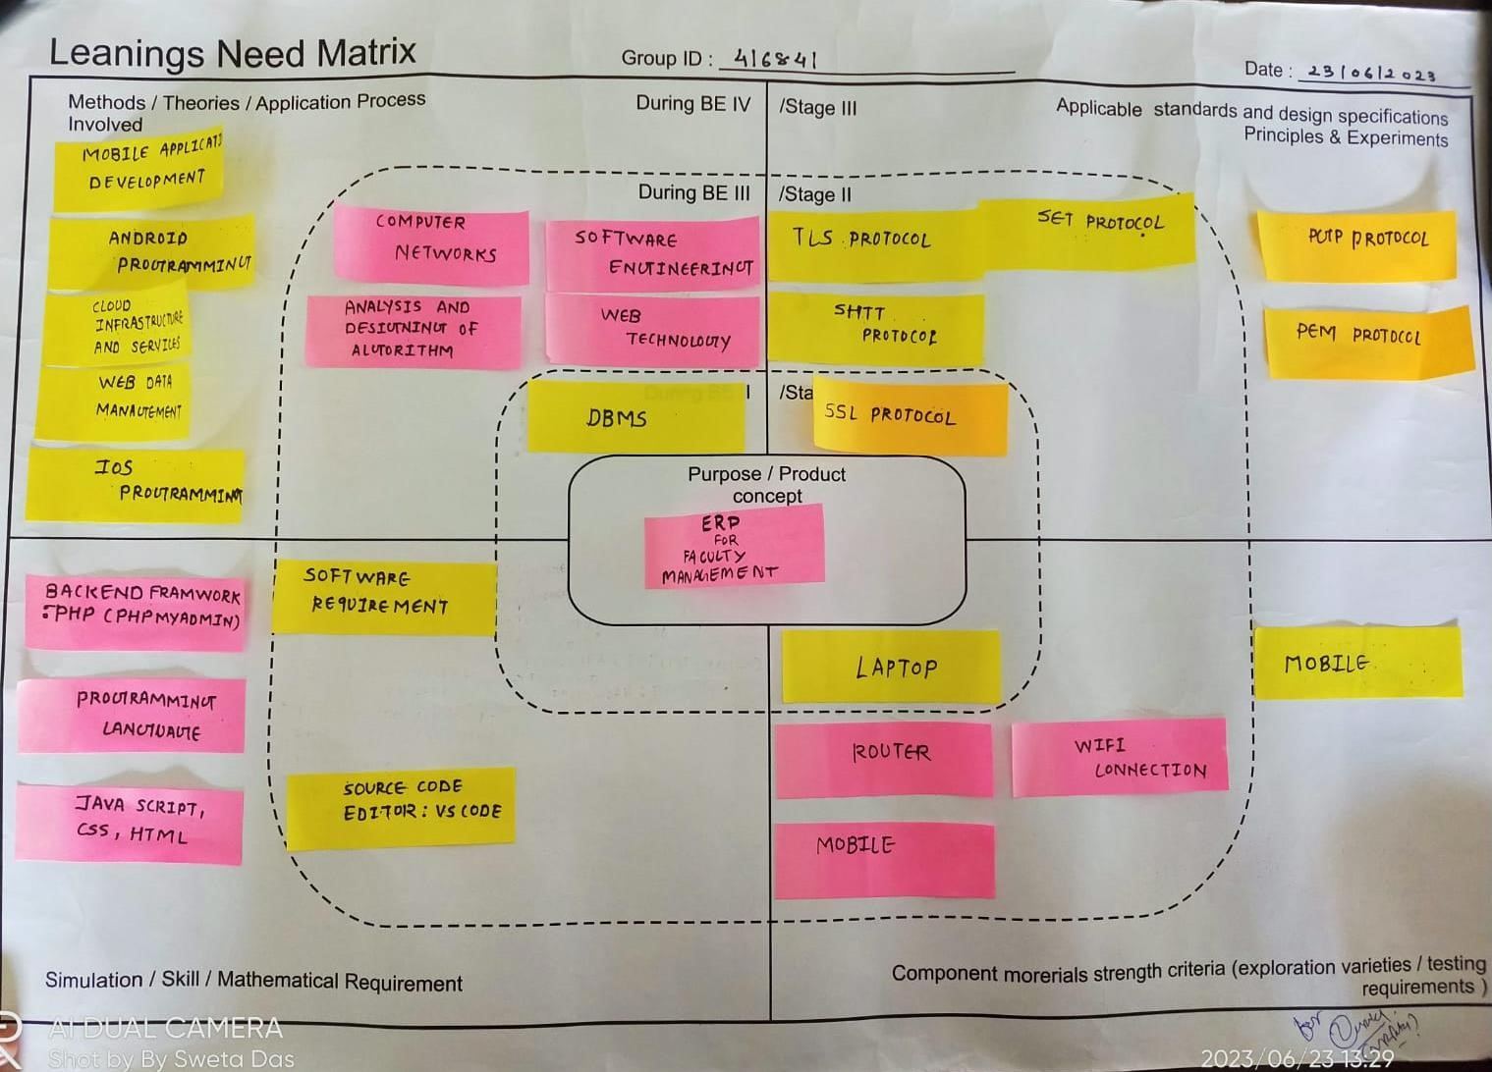
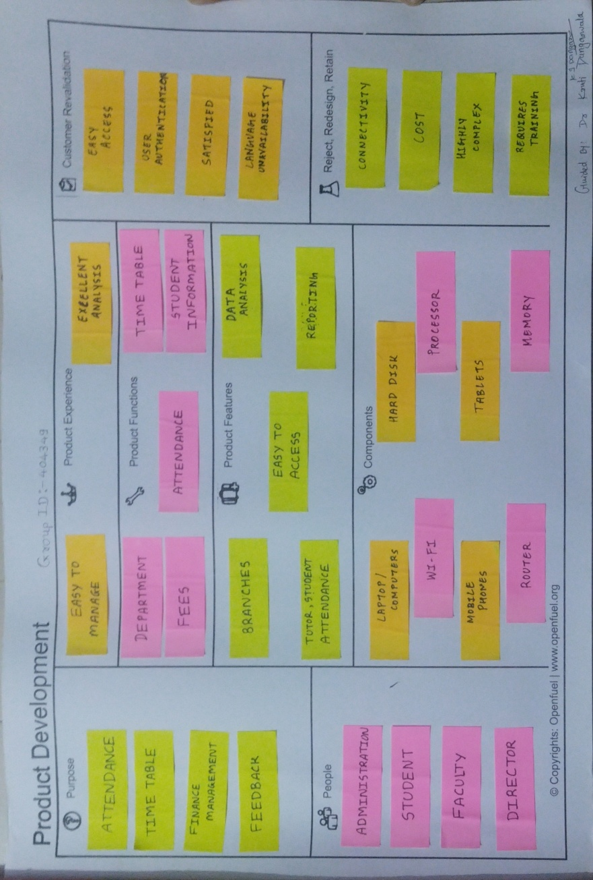
DIFFERENT FRAMEWORKS:-
Learnings Need Matrix Canvas:
Ideation Canvas
Empathy Mapping / Framework:-
Product Development Canvas
Mind Mapping:
People:-
Student
Teachers
Staff
Administrator
Activities :-
Group Discussion
Teaching
Student Registration
Faculties Registration
Presentation
Situation/context/location :-
Administration Office
Administration Process
Exam Form
Book Borrow
Purpose :-
Attendance
Time Table
Finance Management
Feedback
People :-
Student
Faculty
Administration
Director
Product Experience:-
Easy To Manage
Excellent Analysis
Product Functions :-
Department
Fees
Attendance
Time Table
Student Information
Product Features :-
Branches
Easy to Access
Tutor , Computer
Data Analysis
Reporting
Methods:
• Probability & Statical data
• Learning PHP 7.8
• Web data Programming
• Android Programming
Simulation/Skill:
• Java script
• PHP
• Graphical User Interface
Components Morerials Strenght Criteria:
• Laptop
• Mobile
• User Interface
Applicable Standaeds and Design Specification Principles and Experiments :
• Institution Head Permission
• Faculty Permission
A Mind Map is an easy way to brainstorm thoughts organically without worrying about order and structure. It allows you to visually structure your ideas to help with analysis and recall.
The given mind map consists of sixes branches
Users
Modules
Application
Technology
Advantages
Disadvantages
User :-
Admin
Staff
Students
Stakeholders :-
Parents
Director
Librarian
Technician
Empathy Mapping
Activities :-
Teaching
Presentation
Student Registration
Practical Performance
Writing Assignment
Meeting
Mind Mapping:
Ideation Canvas
Product Development
Learnings Need Matrix Canvas:
Props/tools/objects/equipment:-
Computer
Laptop
Mobile
Wi-Fi
Components :-
Wi-Fi
Memory
Mobile
Laptop
Router
Processor
Laravel
Tablet

Slide 7




Research on various ERP system
Deskera
Edusys
Mastersoft
Skolaro
Brief:
MasterSoft is a highly trusted ERP solution provider company with over 800 software implementations across the globe. They offer all aspects of educational solutions such as a learning management system, faculty management system, accreditation management software, and others.
Disadvantages:
1. Cost
2. Speed
Brief:
The EduSys College ERP is the cloud-based college management software system that automates the entire campus operations, reduce operating cost and engage or save more time by bringing different modules such as pre-school, school ERP, coaching centre, college ERP, university ERP.
Disadvantages:
1. Cost
2. Dynamic Features
Brief:
Skolaro is a cloud-based ERP system designed specifically for K-12 schools. It provides a suite of modules that help schools manage their academic and administrative operations efficiently.
Disadvantages:
1. Cost
2. Complexity
Brief:
Deskera’s Faculty Management software allows you to maintain comprehensive faculty management information, including qualifications and skill sets, contract documents, define triggers to remind faculty and administrators of contract expiry dates and more, in the Faculty Management system.
Disadvantages:
1. Faculty attendance tracking
2. Dificulty teminology

Slide 8
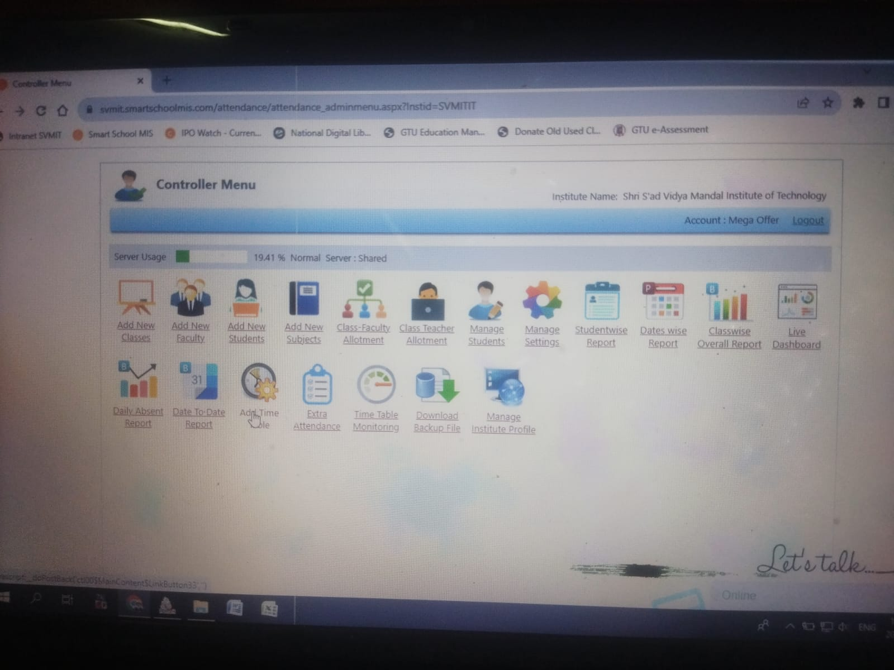
Research our college ERP system
NEEDS: The main needs of our college ERP system is
Flexibility
Too much unnecessary fields
Customization issues

Slide 9
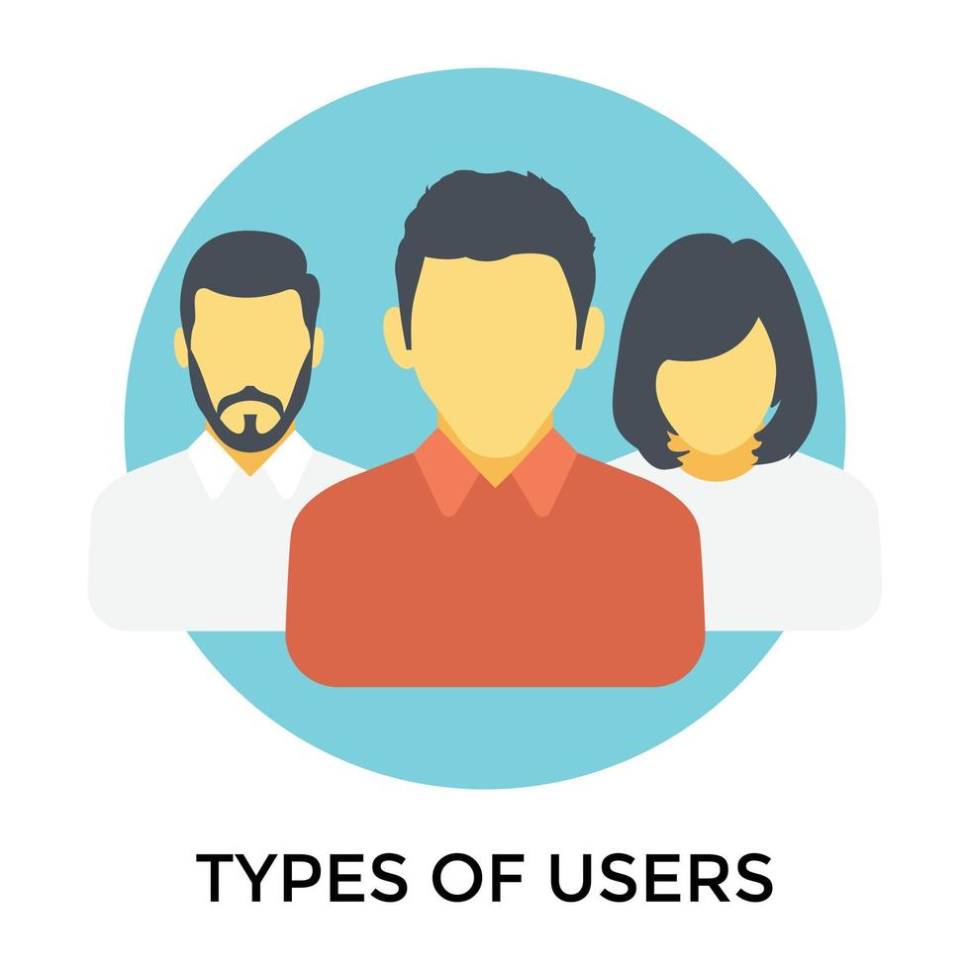


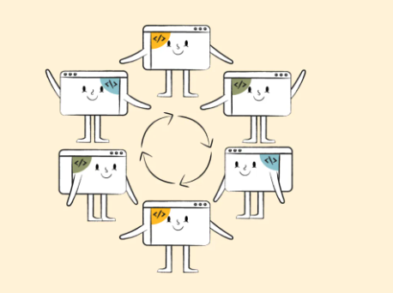

UML Diagrams
Use case Diagrams

Slide 10
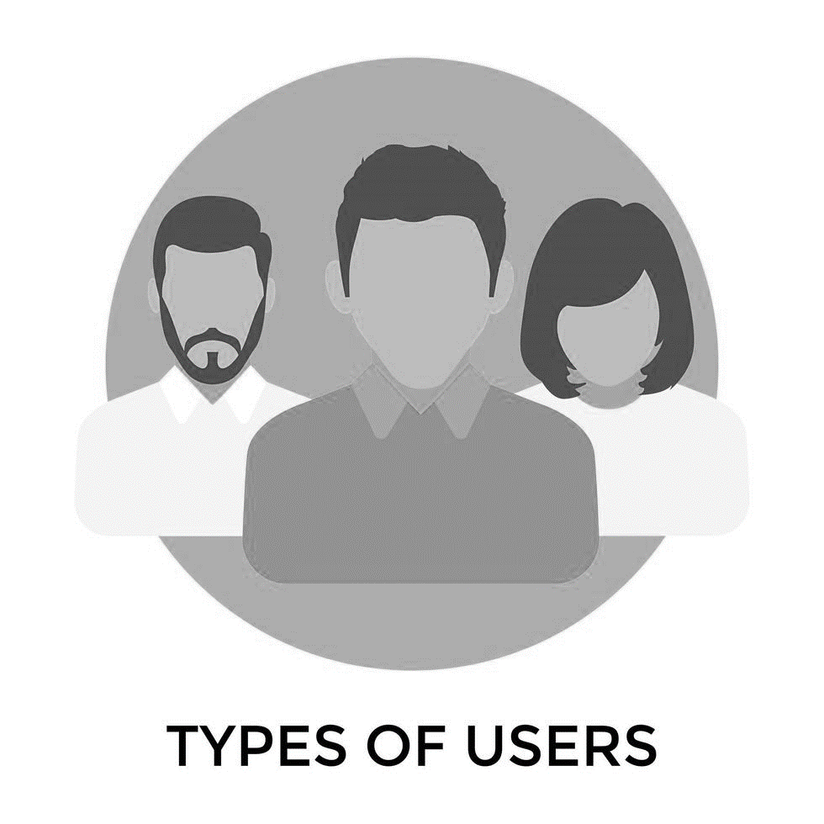
UML Diagrams
State Diagrams

Slide 11
UML Diagrams
Sequence Diagrams

Slide 12
UML Diagrams
Activity Diagrams

Slide 13
UML Diagrams
Class Diagrams

Slide 14
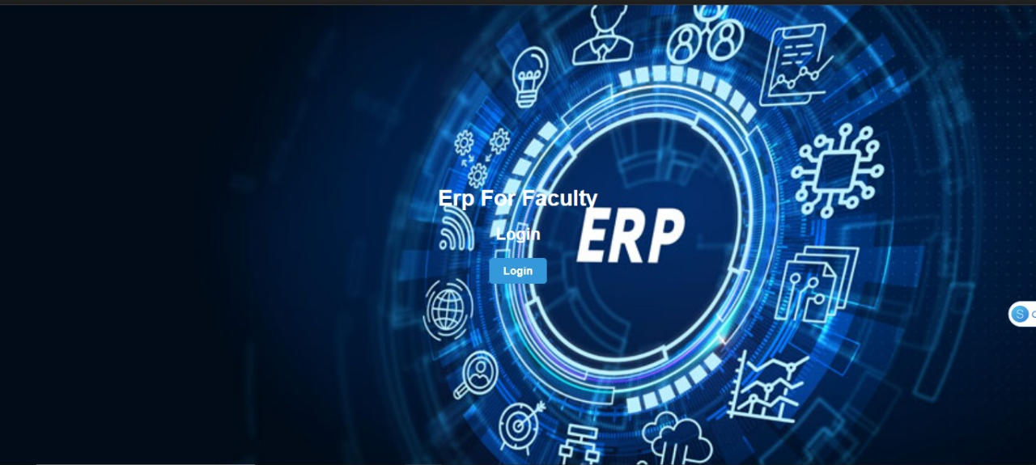
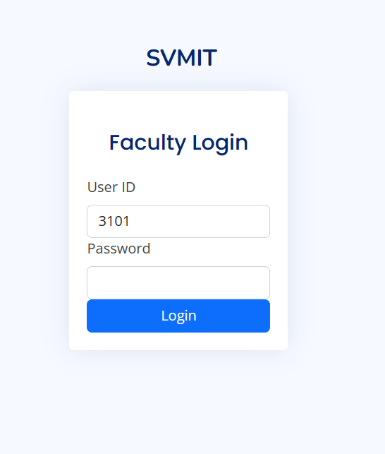
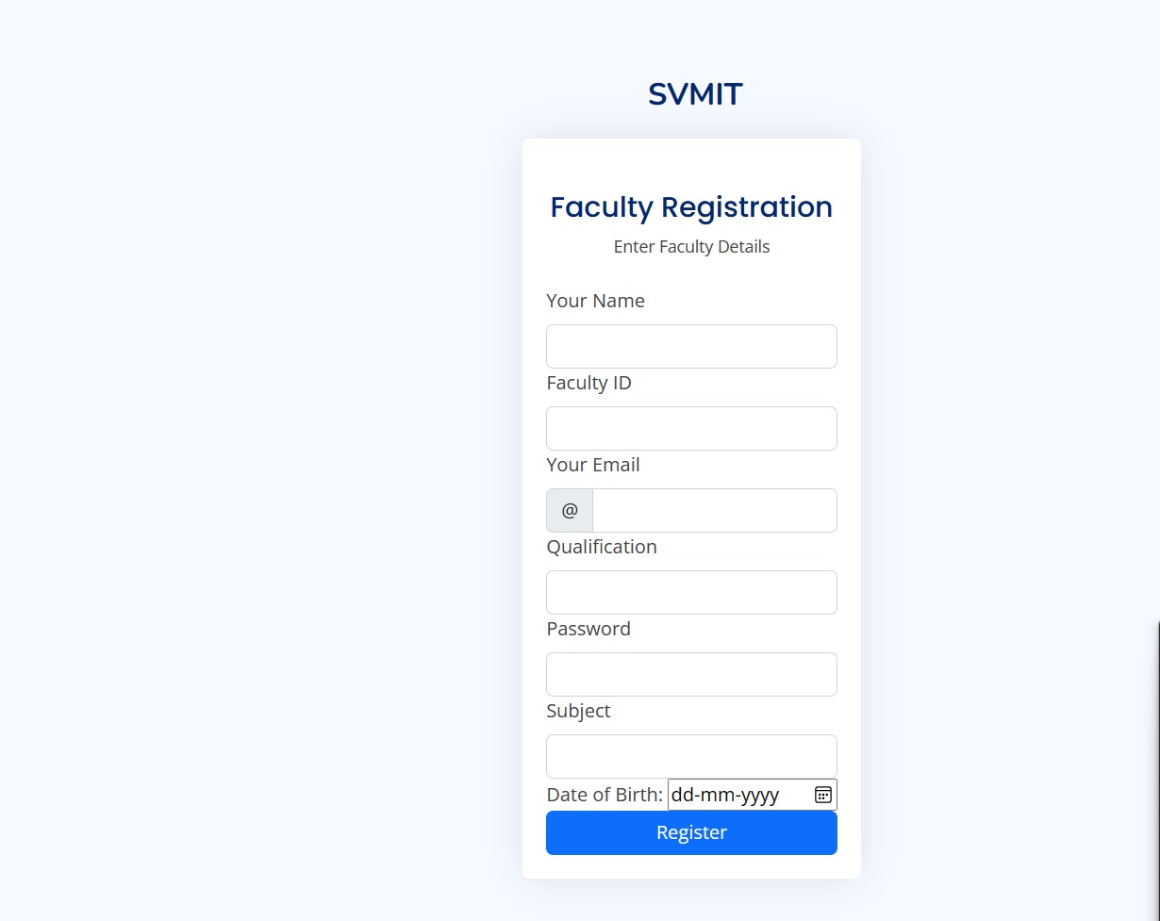
IMPLEMENTATION
First Page
Login Page
Registration

Slide 15
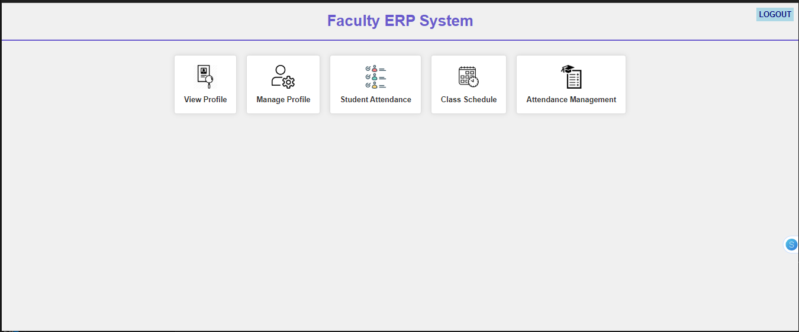
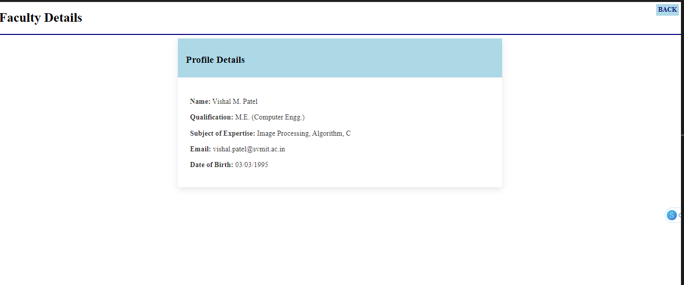
IMPLEMENTATION
Dashboard
View Profile

Slide 16
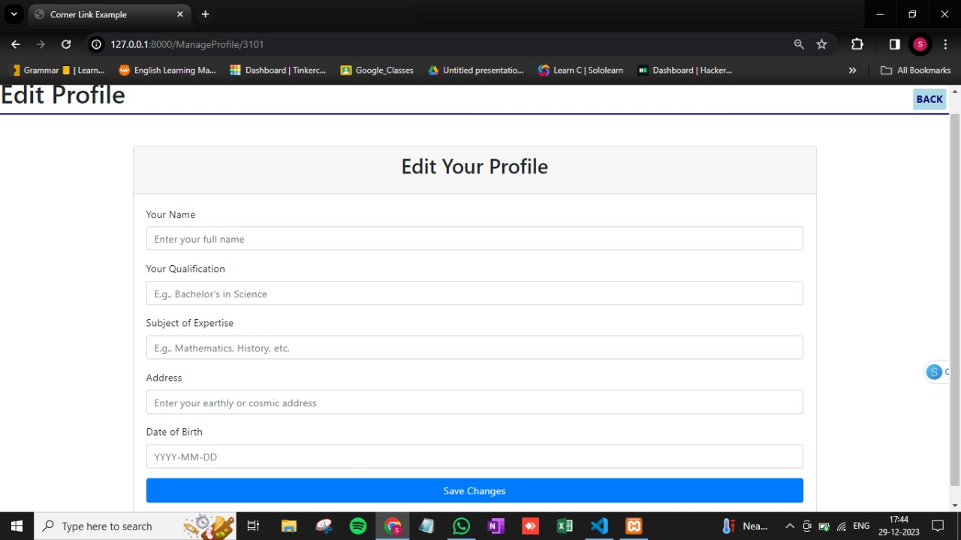
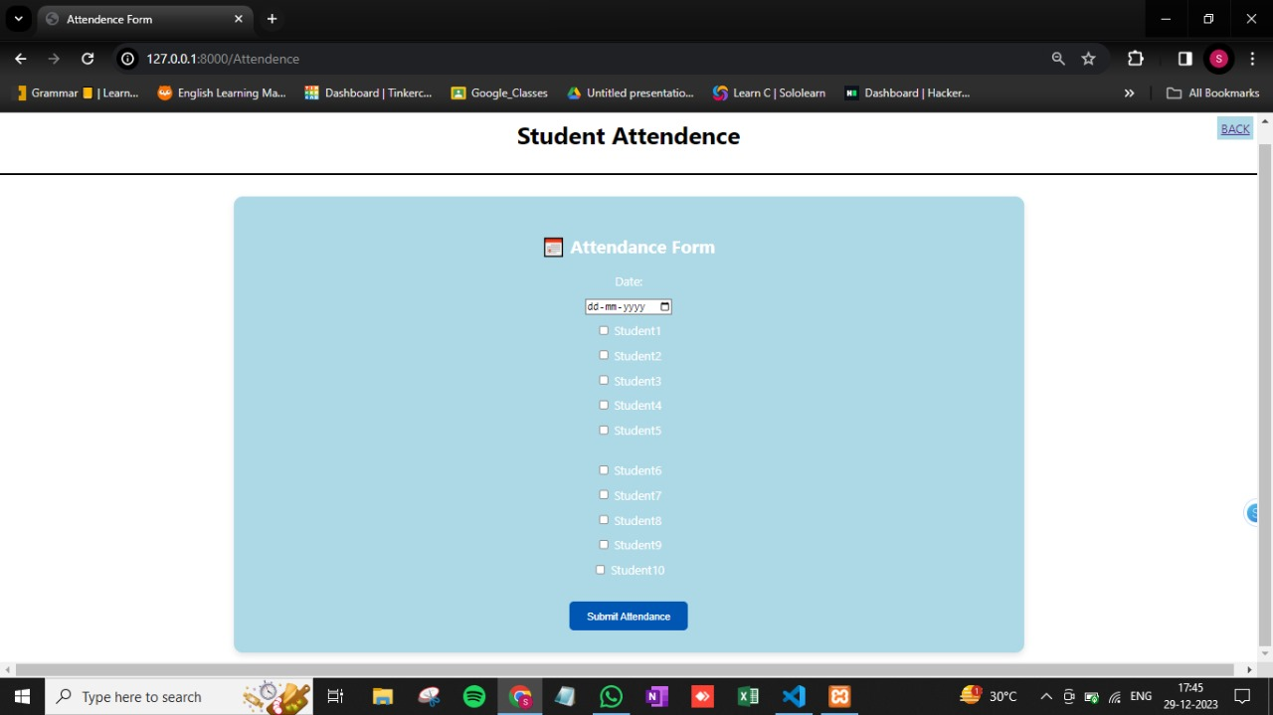
IMPLEMENTATION
Edit Profile
Attendance form

Slide 17
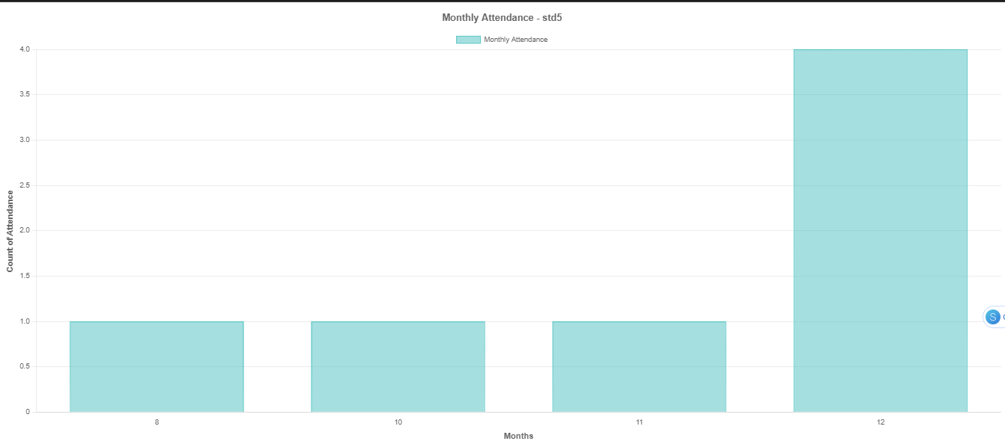
IMPLEMENTATION
Graph of std5

Slide 18
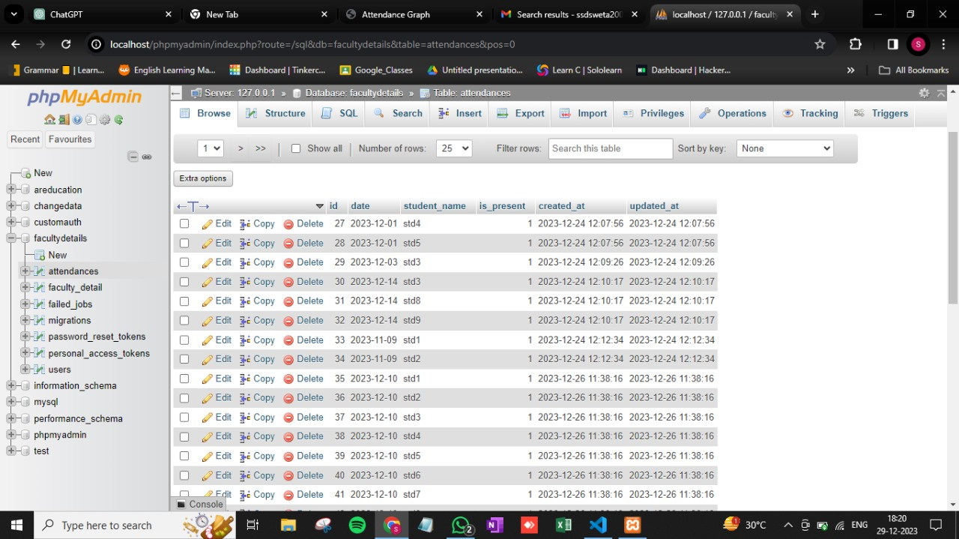
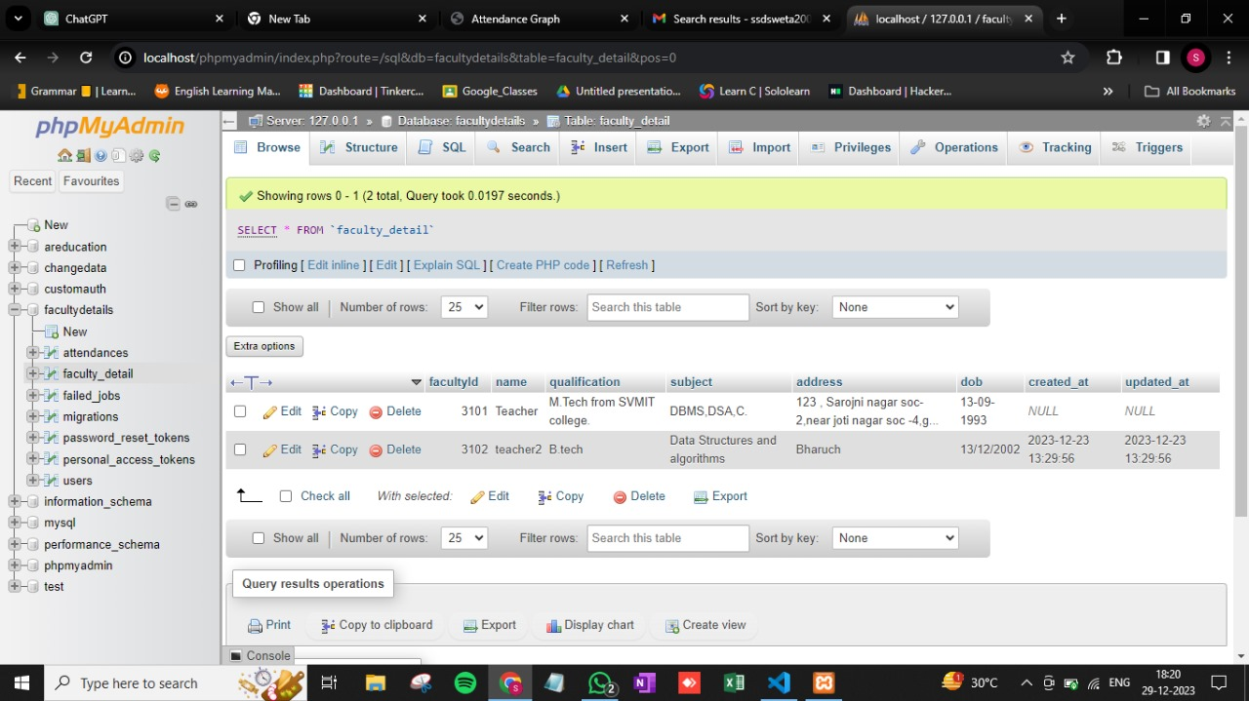
IMPLEMENTATION
Attendance database
Faculty details database

Slide 19
References
Edusys
https://www.edusys.co/en-in/college-management-software.html
MasterSoft
https://www.iitms.co.in/blog/faculty-management-system-software-becoming-a-necessity.html
Skolaro
https://www.skolaro.com/college-erp
Deskera’s Faculty Management software
https://www.deskera.com/lms/faculty-management

Slide 20
Thank You

Slide 22
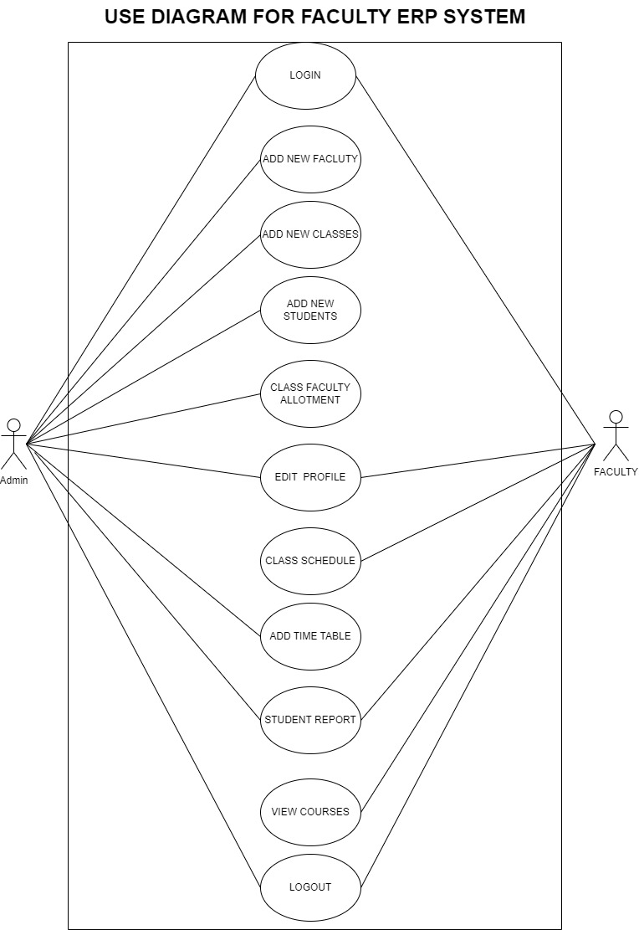
USE CASE DIAGRAM
A Use Case Diagram for a Faculty ERP System illustrates interactions between users and the system.
Actors like professors, administrators, and students engage in various use cases, including course registration, grade management, and attendance tracking.
This diagram visually represents how the ERP system serves and connects these stakeholders in a university setting.
Diagram

Slide 23
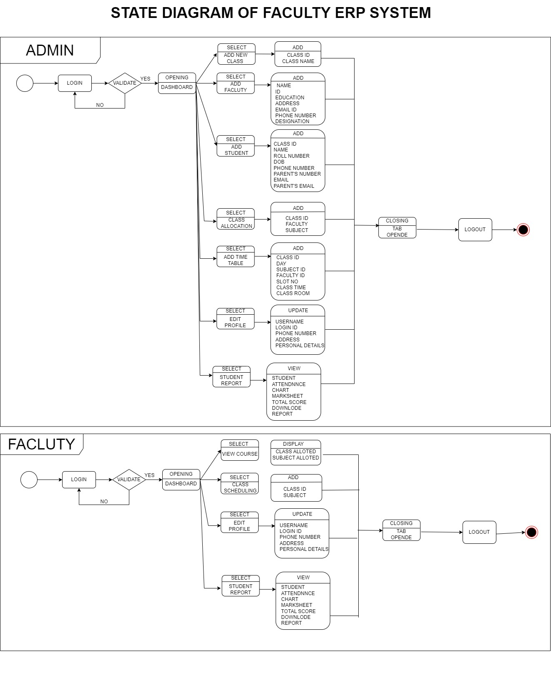
STATE DIAGRAM
A State Diagram for a Faculty ERP System outlines the different states a component or entity within the system can exist in and the transitions between these states. For instance, a “Add new Faculty" component may transition from "Open for Registration" to "Closed for Registration." This diagram clarifies the system's behavior and helps in understanding its operational states and transitions.
Diagram

Slide 24
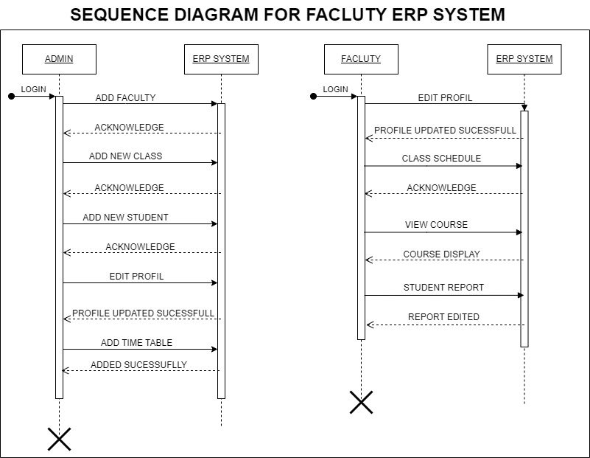
SEQUENCE DIAGRAM
A Sequence Diagram for a Faculty ERP System depicts the chronological flow of interactions between various system components, including actors and objects.
It illustrates the specific sequence of messages or actions exchanged during a particular use case, like "Student Course Registration." This diagram provides a dynamic view, highlighting the order and timing of activities in the system, aiding in understanding its functionality and data flow.
Diagram

Slide 25
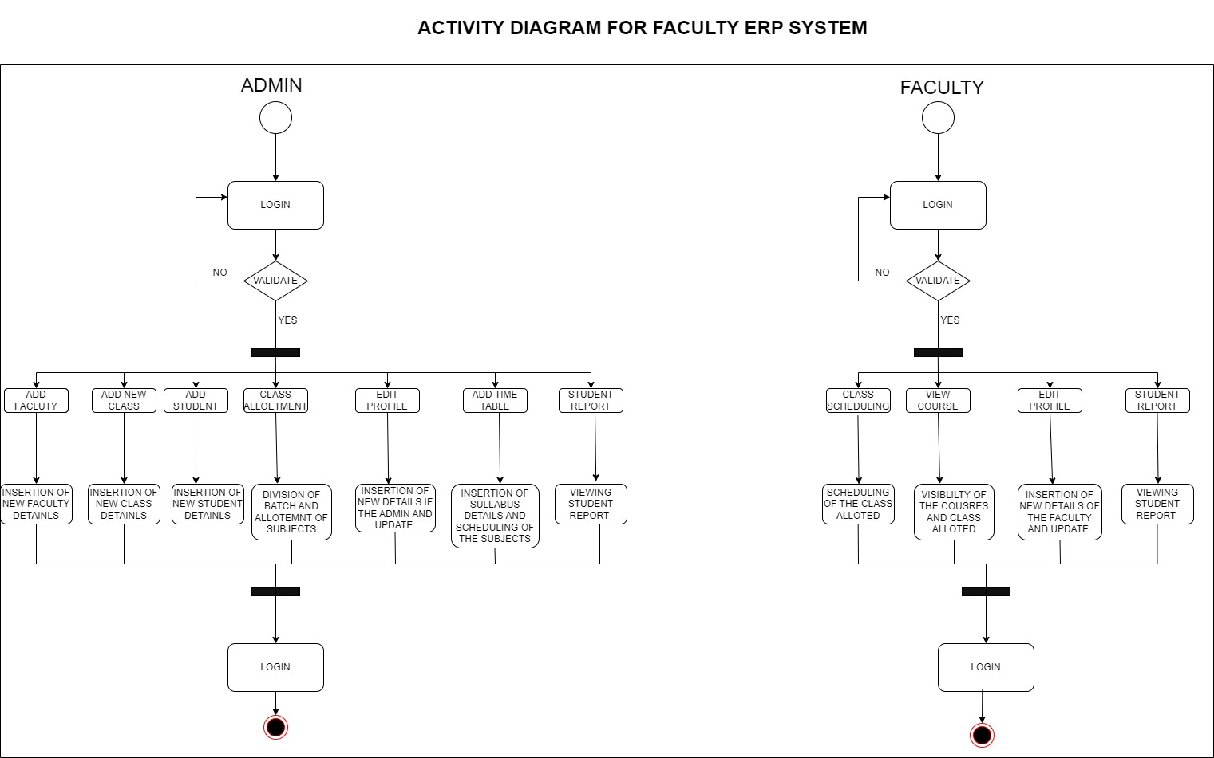
ACTIVITY DIAGRAM
The activity diagram consists of the functions that a user can perform
The admin has the most of the access of the dashboard including all the features of the system
The faculty has all the class related and courses view options
Diagram

Slide 26
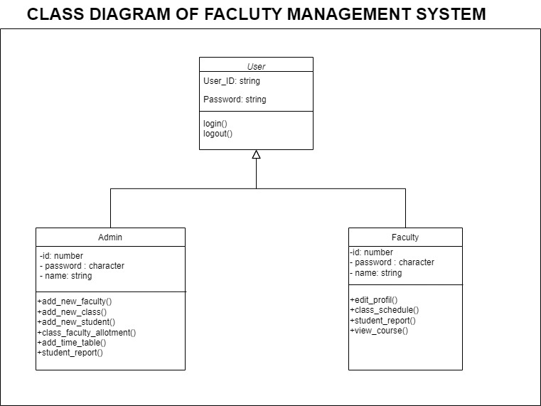
CLASS DIAGRAM
A Class Diagram for a Faculty ERP System represents the system's structure and the relationships between its classes or objects.
It identifies the major components, such as "Student," "Professor," "Course," and their attributes and methods. Arrows between classes indicate associations, like a student being enrolled in a course.
This diagram offers a static view, helping to visualize the system's data structure and the way different elements are connected.
Diagram

